Slide 1


Closeness Centrality
A
B
C
D
E
0.1
0.14
0.16
0.14
0.1
C_{clos}(A) = C_{clos}(E) = 1 / (1+2+3+4) = 1/10 = 0.1
C_{clos}(B) = C_{clos}(D) = 1 / (1+1+2+3) = 1/7 = 0.14
C_{clos}(C) = 1 / (2+1+1+2) = 1/6 = 0.16

Slide 2
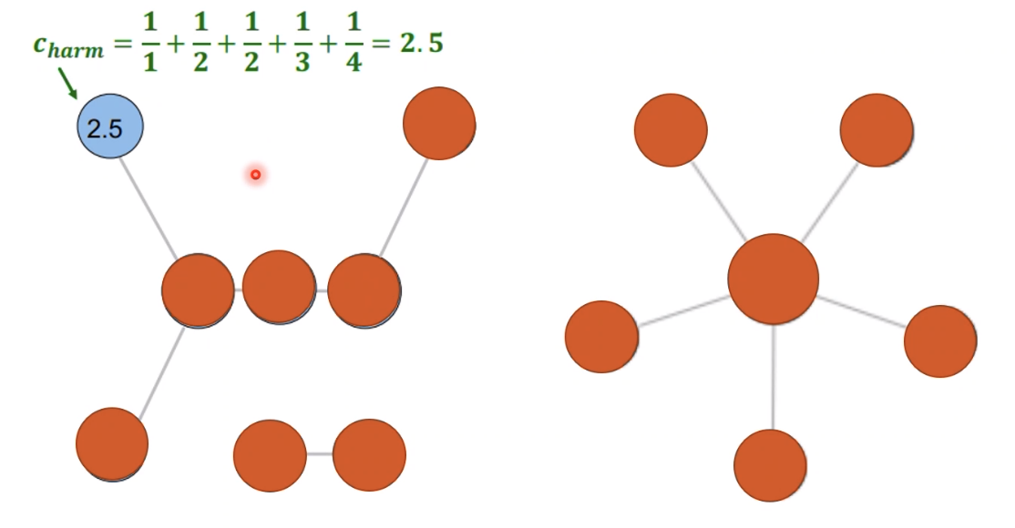
Harmonic Centrality

Slide 3
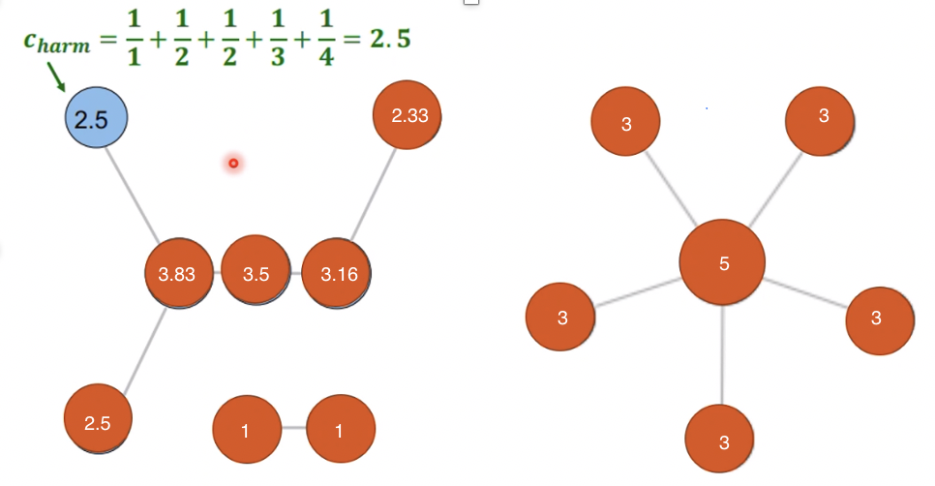
Harmonic Centrality

Slide 4
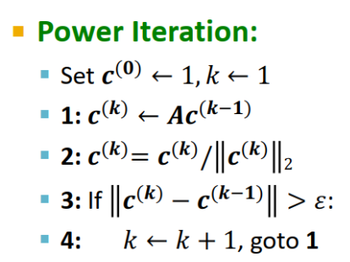

Slide 5

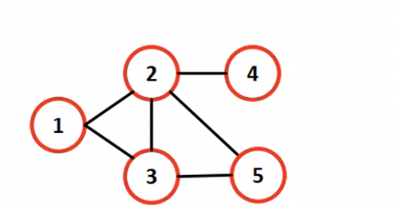
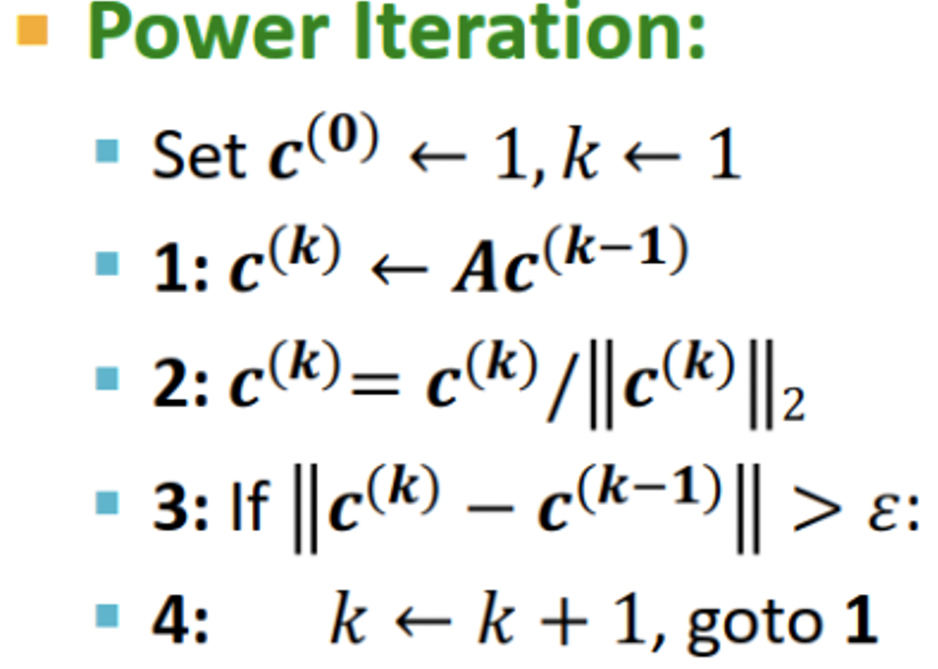
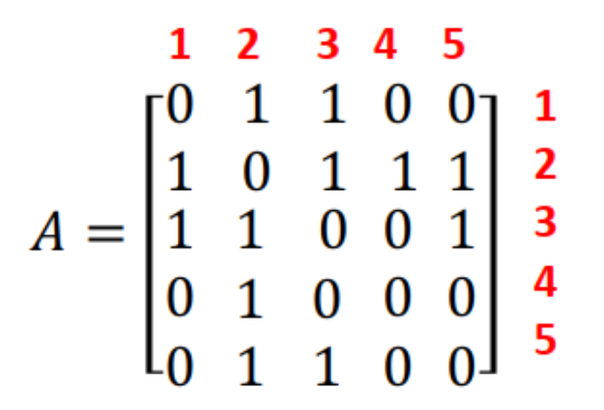
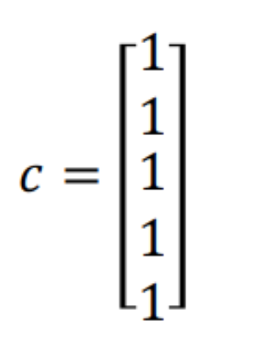
k=1

Slide 6
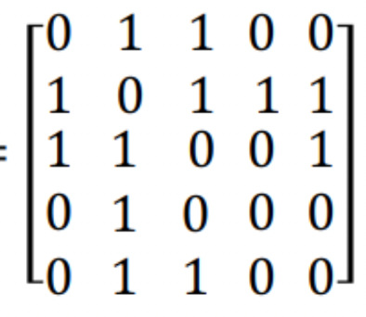
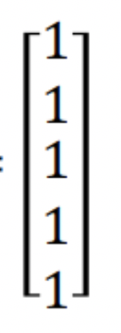


k=1
c1 = A . c0
c1 =
X
=

Slide 7
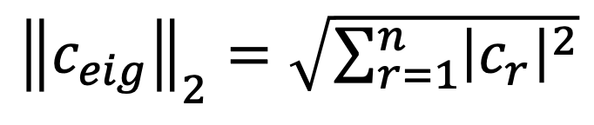
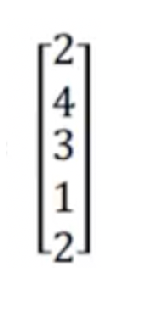
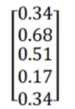


k = 1
/
=

Slide 8
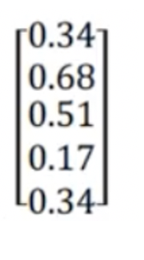

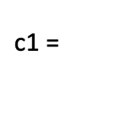
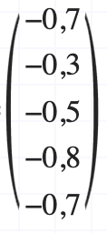
k=1
c0 =
c1-c0 =
=>

Slide 9
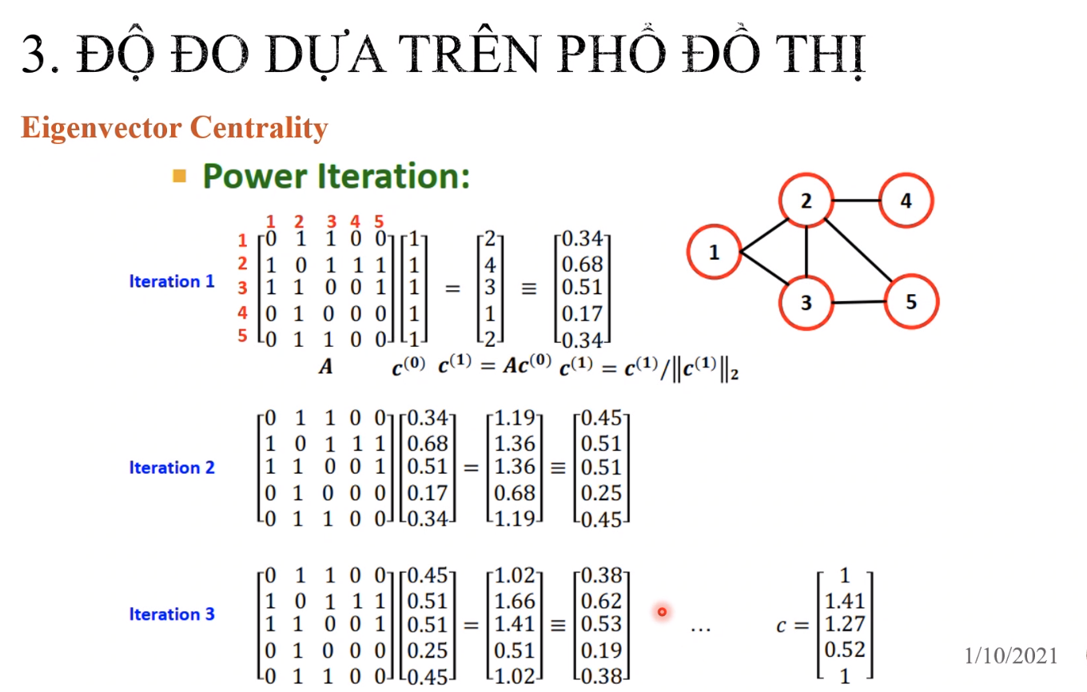

Slide 10
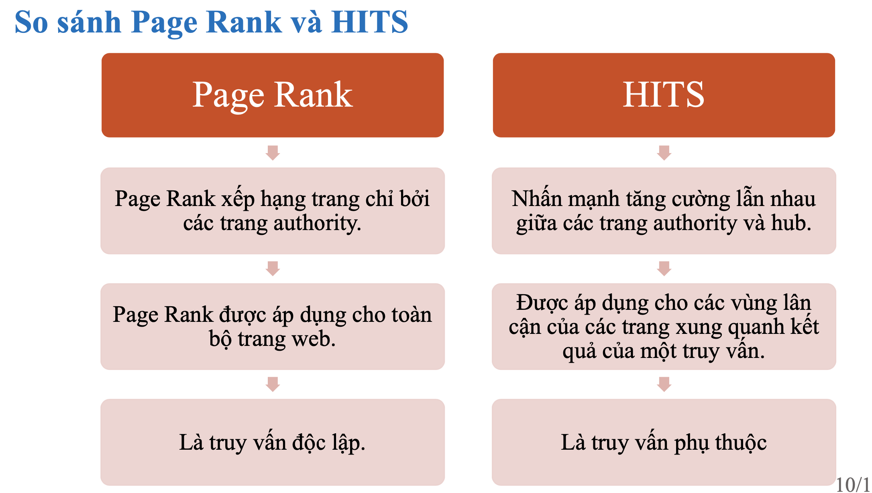

Slide 11
